Slide 1

Helios: A Hybrid Electrical/Optical Switch Architecture for Modular Data Centers
Nathan Farrington
George Porter, Sivasankar Radhakrishnan, Hamid Hajabdolali Bazzaz, Vikram Subramanya, Yeshaiahu Fainman, George Papen, and Amin Vahdat

Slide 2
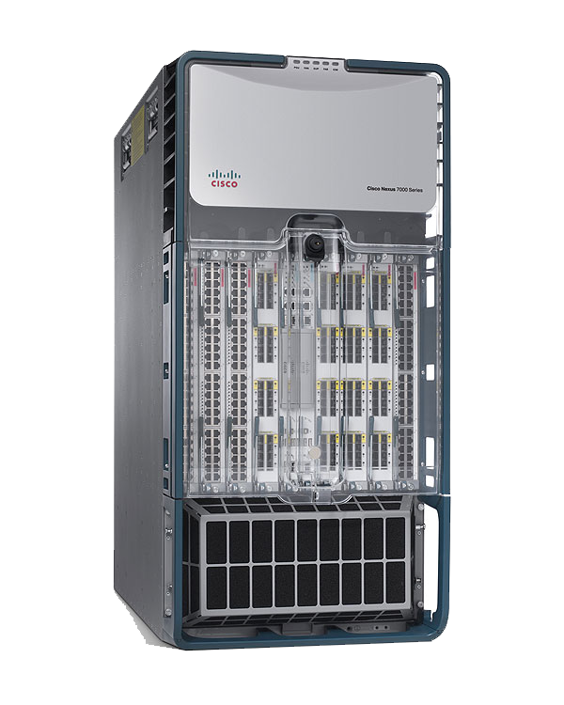
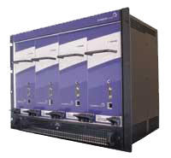
Electrical Packet Switch
Optical Circuit Switch
$500/port
10 Gb/s fixed rate
12 W/port
Requires transceivers
Per-packet switching
For bursty, uniform traffic
$500/port
Rate free
240 mW/port
No transceivers
12 ms switching time
For stable, pair-wise traffic
Notes:
Mixing both types of switches in the same network allows one type of switch to compensate for the weaknesses of the other type.
We route the stable traffic over the optical circuit switches and the bursty traffic over the electrical packet switches.

Slide 3
Intro
Technology
Analysis
Data Plane
Control Plane
Experimental Setup
Evaluation
Related Work
Conclusion

Slide 4
Optical Circuit Switch
Output 1
Output 2
Fixed
Mirror
Lenses
Input 1
Glass Fiber
Bundle
Full crossbar switch
Does not decode packets
Needs external scheduler
Rotate Mirror
Mirrors on Motors
Notes:
This animation shows the workings of an optical circuit switch.
Glass fiber brings a light beam from an input port to a lens, which focus the light as it exits the fiber.
The light beam then travels through the air and reflects off of a mirror, then another mirror, then a third mirror, and finally gets focused through a second lens, then travels over fiber to an output port.
Some mirrors are attached to motors, so if we want to choose a different output port, then we can rotate a mirror to select a different port.

Slide 5

Wavelength Division Multiplexing
Optical Circuit Switch
No Transceivers
Required
80G
Superlink
WDM MUX
WDM DEMUX
10G
WDM Optical
Transceivers
1
2
3
4
5
6
7
8
Electrical Packet Switch
Notes:
1. Each 10 Gb/s transceiver in a LAG uses a non-overlapping wavelength (IEEE 802.1AX-2008 Link Aggregation Group).
2. This LAG, called a superlink, can fit onto a single fiber pair.
3. Superlinks are transparent to the packet switches, which deal only with LAGs.

Slide 6
Stability Increases with Aggregation
Inter-Data Center
Where is the
Sweet Spot?
Inter-Pod
Inter-Rack
Enough Stability
Enough Traffic
Inter-Server
Inter-Process
Inter-Thread

Slide 7
Intro
Technology
Analysis
Data Plane
Control Plane
Experimental Setup
Evaluation
Related Work
Conclusion

Slide 8
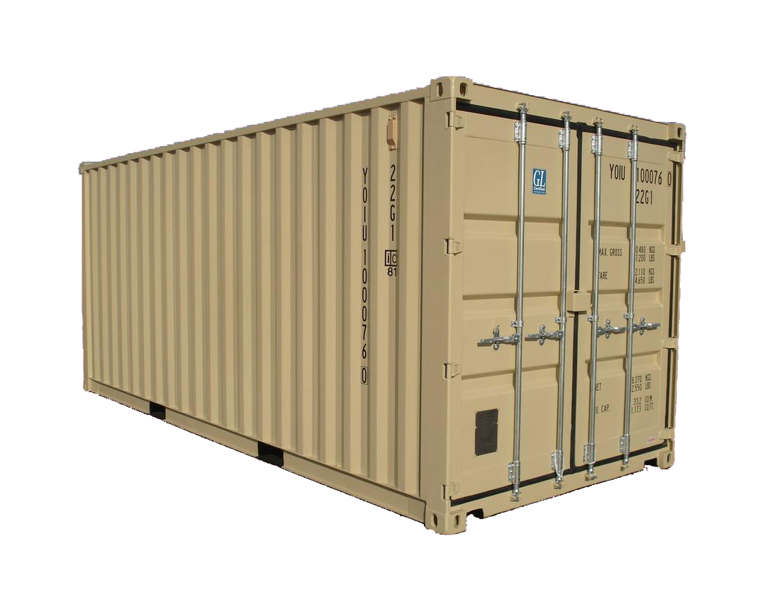
k switches, N-ports each
N pods, k-ports each
Example: N=64 pods * k=1024 hosts/pod = 64K hosts total; 8 wavelengths
Bisection Bandwidth | 10% Electrical (10:1 Oversubscribed) | 100% Electrical | Helios Example 10% Electrical + 90% Optical
Cost | $6.3 M
Power | 96.5 kW
Cables | 6,656
Notes:
Start out by connecting all of the pod switches to a single core packet switch.
Additional core packet switches can be added as needed.
Running example of a 64K-host data center, partitioned into 64 pods of 1,024 hosts each.
Allocating for just the baseline will lead to bottlenecks for communication-intensive applications.
1024 = 104 + 920
Packet Switch Port: $500 (12.5W)
Circuit Switch Port: $500 (0.24W)
Transceiver (w < 8): $200 (1W)
Fiber: $50
920 / 8 = 115
Cost 10% Static: cost(trans) + cost(ports) + cost(fiber) = 104*64*$400 + 104*64*$500 + 104*64*$50 = $6,323,200
Cost 100% Static: cost(trans) + cost(ports) + cost(fiber) = 1024*64*$400 + 1024*64*$500 + 1024*64*$50 = $62,259,200
Cost Helios: cost(trans) + cost(ports) + cost(fiber) = 1024*64*$200 + 104*64*$200 + (104*64+115*64)*$500 + (104*64+115*64)*$50 = $22,147,200
Power 10% Static: 104*64*(12.5W+2W) = 96,512 W
Power 100% Static: 1024*64*(12.5W+2W) = 950,272 W
Power Helios: 1024*64*1W + 104*64*(12.5W+1W) + 115*64*(0.24W) = 157,158 W
Cables 10% Static: 104 * 64 = 6,656
Cables 100% Static: 1024 * 64 = 65,536
Cables Helios: 6,656 + 115 * 64 = 7,360 = 14,016

Slide 9
k switches, N-ports each
N pods, k-ports each
Example: N=64 pods * k=1024 hosts/pod = 64K hosts total; 8 wavelengths
Bisection Bandwidth | 10% Electrical (10:1 Oversubscribed) | 100% Electrical | Helios Example 10% Electrical + 90% Optical
Cost | $6.3 M | $62.3 M
Power | 96.5 kW | 950.3 kW
Cables | 6,656 | 65,536
Notes:
1. 100% bisection bandwidth can be achieved for any traffic pattern, but at significant cost, power, and cabling complexity.

Slide 10
Less than k switches, N-ports each
Fewer Core
Switches
N pods, k-ports each
Example: N=64 pods * k=1024 hosts/pod = 64K hosts total; 8 wavelengths
Bisection Bandwidth | 10% Electrical (10:1 Oversubscribed) | 100% Electrical | Helios Example 10% Electrical + 90% Optical
Cost | $6.3 M | $62.2 M | $22.1 M | 2.8x Less
Power | 96.5 kW | 950.3 kW | 157.2 kW | 6.0x Less
Cables | 6,656 | 65,536 | 14,016 | 4.7x Less
Notes:
1. Optical circuit switches are used for smooth traffic.
2. Electrical packet switches are used for bursty traffic.
3. Aggregating thousands of nodes into pods helps smooth the traffic, and makes optical circuit switching more cost effective.
4. In the best case, the Helios example will have the same performance as the 100% Electrical example.
5. In the worst case, the Helios example will have the same performance as the 10% Electrical example.

Slide 11
Intro
Technology
Analysis
Data Plane
Control Plane
Experimental Setup
Evaluation
Related Work
Conclusion

Slide 12
Setup a Circuit
Pod 1 -> 2:
Capacity = 10G
Demand = 10G
Throughput = 10G
Pod 1 -> 3:
Capacity = 80G
Demand = 80G
Throughput = 80G
EPS
OCS
10G
80G
10G
80G
10G
80G
Pod 1
Pod 2
Pod 3

Slide 13
Traffic Patterns Change
Pod 1 -> 2:
Capacity = 10G
Demand = 10G
Throughput = 10G
Pod 1 -> 3:
Capacity = 80G
Demand = 80G
Throughput = 80G
EPS
OCS
10G
80G
10G
80G
10G
80G
Pod 1
Pod 2
Pod 3

Slide 14
Traffic Patterns Change
Pod 1 -> 2:
Capacity = 10G
Demand = 10G 80G
Throughput = 10G
Pod 1 -> 3:
Capacity = 80G
Demand = 80G 10G
Throughput = 10G
EPS
OCS
10G
80G
10G
80G
10G
80G
Pod 1
Pod 2
Pod 3

Slide 15
Break a Circuit
Pod 1 -> 2:
Capacity = 10G
Demand = 10G 80G
Throughput = 10G
Pod 1 -> 3:
Capacity = 80G
Demand = 80G 10G
Throughput = 10G
EPS
OCS
10G
80G
10G
80G
10G
80G
Pod 1
Pod 2
Pod 3

Slide 16
Setup a Circuit
Pod 1 -> 2:
Capacity = 10G
Demand = 10G 80G
Throughput = 10G
Pod 1 -> 3:
Capacity = 80G
Demand = 80G 10G
Throughput = 10G
EPS
OCS
10G
80G
10G
80G
10G
80G
Pod 1
Pod 2
Pod 3

Slide 17
Pod 1 -> 2:
Capacity = 80G
Demand = 80G
Throughput = 80G
Pod 1 -> 3:
Capacity = 80G
Demand = 80G 10G
Throughput = 10G
EPS
OCS
10G
80G
10G
80G
10G
80G
Pod 1
Pod 2
Pod 3

Slide 18
Pod 1 -> 2:
Capacity = 80G
Demand = 80G
Throughput = 80G
Pod 1 -> 3:
Capacity = 10G
Demand = 10G
Throughput = 10G
EPS
OCS
10G
80G
10G
80G
10G
80G
Pod 1
Pod 2
Pod 3

Slide 19
Intro
Technology
Analysis
Data Plane
Control Plane
Experimental Setup
Evaluation
Related Work
Conclusion

Slide 20
Topology
Manager
EPS
OCS
Circuit Switch
Manager
10G
80G
10G
80G
10G
80G
Pod Switch
Manager
Pod Switch
Manager
Pod Switch
Manager
Pod 1
Pod 2
Pod 3

Slide 21
Outline of Control Loop
Estimate traffic demand
Compute optimal topology for maximum throughput
Program the pod switches and circuit switches

Slide 22
1. Estimate Traffic Demand
Question: Will this flow use more bandwidth if we give it more capacity?
Identify elephant flows (mice don’t grow)
Problem: Measurements are biased by current topology
Pretend all hosts are connected to an ideal crossbar switch
Compute the max-min fair bandwidth fixpoint
Mohammad Al-Fares, Sivasankar Radhakrishnan, Barath Raghavan, Nelson Huang, and Amin Vahdat. Hedera: Dynamic Flow Scheduling for Data Center Networks. In NSDI’10.
Notes:
The measured demand is biased with the current network topology and poorly reflects the actual demand.
Our approach is to estimate the actual demand using these biased measurements.

Slide 23
2. Compute Optimal Topology
Formulate as instance of max-weight perfect matching problem on bipartite graph
Solve with Edmonds algorithm
Source Pods
Destination Pods
1
1
Pods do not send traffic to themselves
Edge weights represent interpod demand
Algorithm is run iteratively for each circuit switch, making use of the previous results
2
2
3
3
4
4

Slide 24
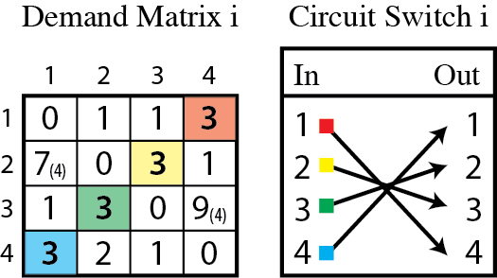
Example: Compute Optimal Topology
Notes:
The number 4 is used in the max-weighted matching algorithm, not 7 or 9.
The number 4 is the capacity of the superlink.

Slide 25
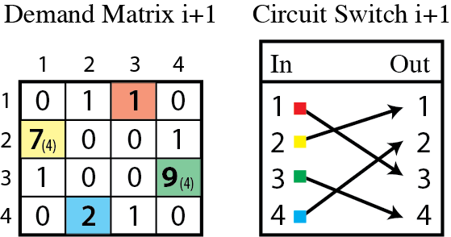
Example: Compute Optimal Topology

Slide 26
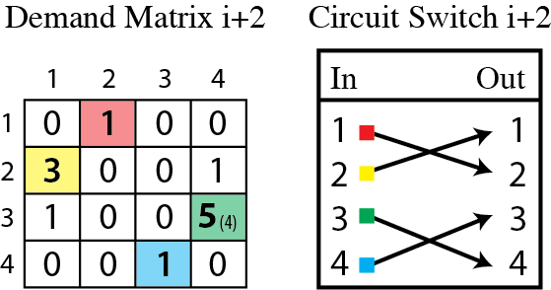
Example: Compute Optimal Topology

Slide 27
Intro
Technology
Analysis
Data Plane
Control Plane
Experimental Setup
Evaluation
Related Work
Conclusion

Slide 28
Traditional Network
Helios Network
100% bisection bandwidth
(240 Gb/s)

Slide 29
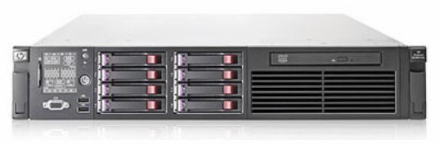
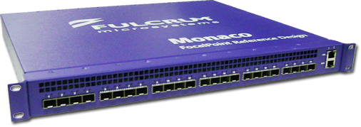
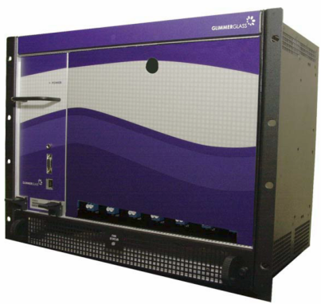
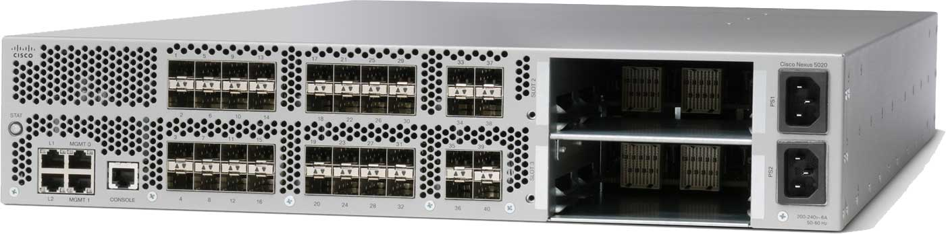
Hardware
24 servers
HP DL380
2 socket (E5520) Nehalem
Dual Myricom 10G NICs
7 switches
One Dell 1G 48-port
Three Fulcrum 10G 24-port
One Glimmerglass 64-port optical circuit switch
Two Cisco Nexus 5020 10G 52-port

Slide 30
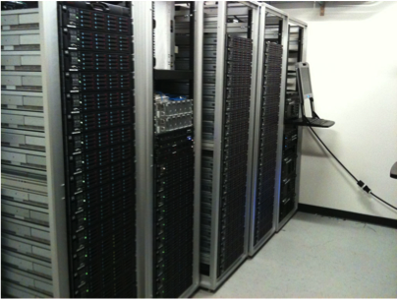
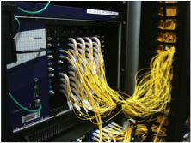

Slide 31
Intro
Technology
Analysis
Data Plane
Control Plane
Experimental Setup
Evaluation
Related Work
Conclusion

Slide 32
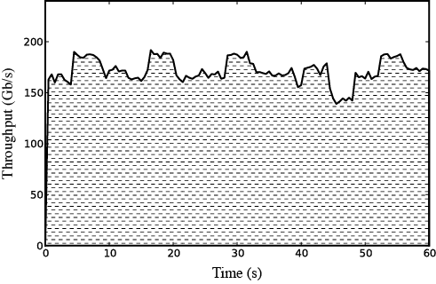
Traditional Network
Hash Collisions
TCP/IP Overhead
190 Gb/s Peak
171 Gb/s Avg
Notes:
Traffic demand changes every 4 seconds.
Inconsistent throughput a result of hash collisions on LAG forwarding.

Slide 33
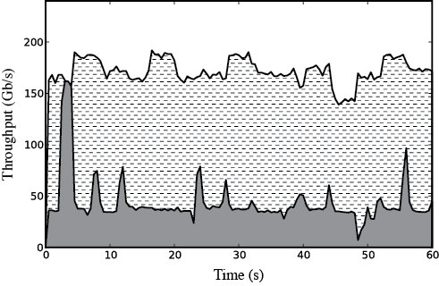
Helios Network (Baseline)
160 Gb/s Peak
43 Gb/s Avg

Slide 34
Port Debouncing
Layer 1 PHY signal locked (bits are detected)
Switch thread wakes up and polls for PHY status
Makes note to enable link after 2 seconds
Switch thread enables Layer 2 link
0.0
0.25
0.5
0.75
1.0
1.25
1.5
1.75
2.0
Time (s)

Slide 35
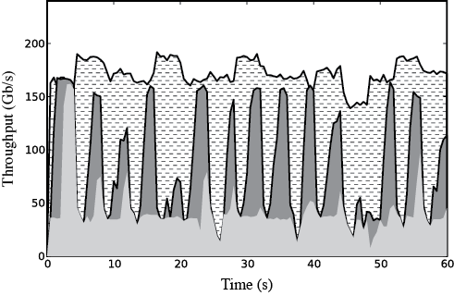
Without Debouncing
160 Gb/s Peak
87 Gb/s Avg

Slide 36
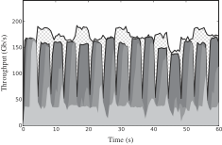
Without EDC
Software Limitation
27 ms Gaps
160 Gb/s Peak
142 Gb/s Avg
Notes:
Most of performance loss in Helios is during circuit switch reconfigurations where no traffic can flow over circuits.
Traditional performance is sometimes greater than Helios due to a limitation of not being able to spread traffic over packet switch and circuit switches simultaneously. This appears to be a software limitation of our particular pod switch manager and does not appear to be a hardware limitation.

Slide 37
Bidirectional Circuits
Optical Circuit Switch
RX
TX
RX
TX
RX
TX
Pod Switch
Pod Switch
Pod Switch

Slide 38
Unidirectional Circuits
Optical Circuit Switch
RX
TX
RX
TX
RX
TX
Pod Switch
Pod Switch
Pod Switch

Slide 39
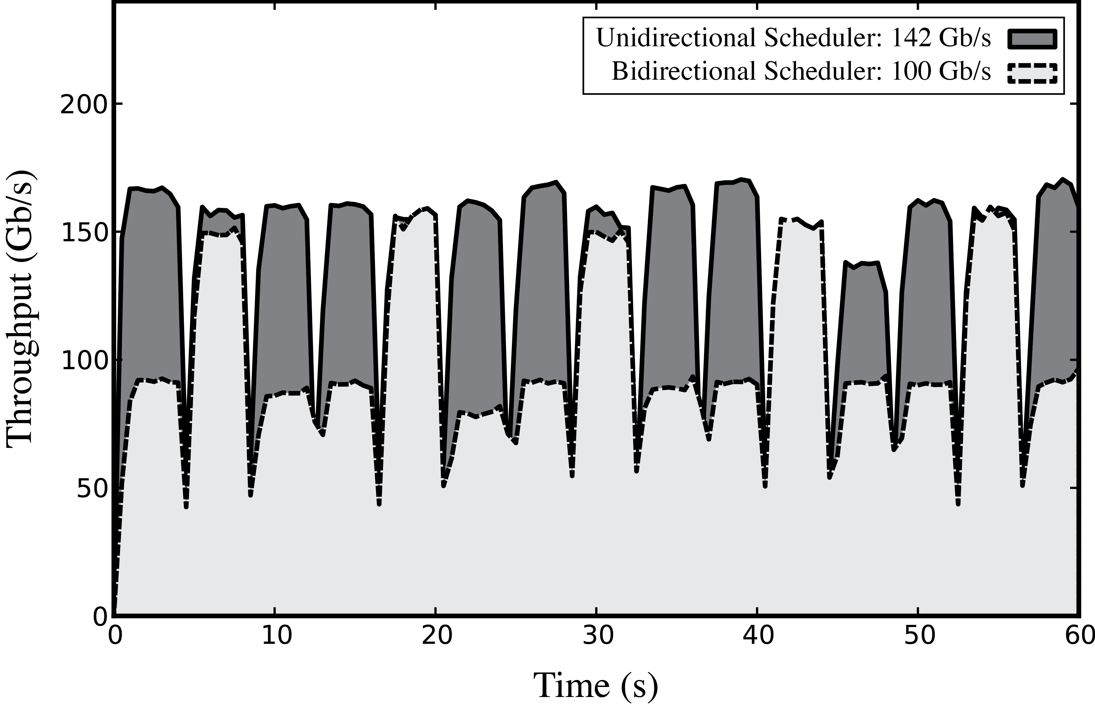
Unidirectional Circuits
Unidirectional Scheduler
142 Gb/s Avg
Daisy Chain Needed for Good Performance
For Arbitrary Traffic Patterns
Bidirectional Scheduler
100 Gb/s Avg

Slide 40
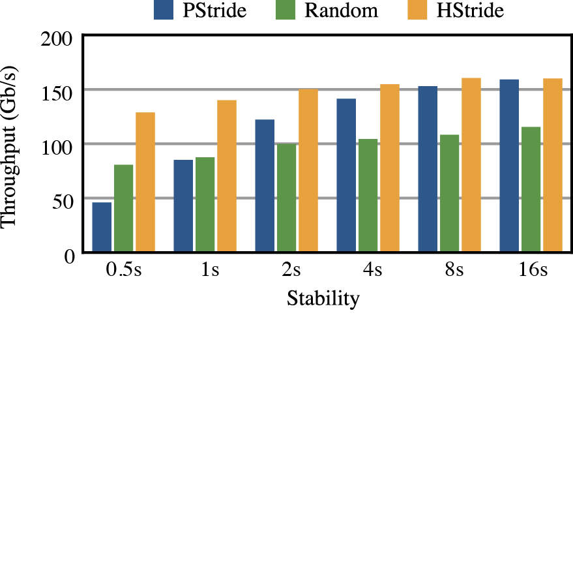
Traffic Stability and Throughput

Slide 41
Intro
Technology
Analysis
Data Plane
Control Plane
Experimental Setup
Evaluation
Related Work
Conclusion

Slide 42
 | Link Technology | Modifications Required | Working Prototype
Helios (SIGCOMM ‘10) | Optics w/ WDM 10G-180G (CWDM) 10G-400G (DWDM) | Switch Software | Glimmerglass, Fulcrum
c-Through (SIGCOMM ’10) | Optics (10G) | Host OS | Emulation
Flyways (HotNets ‘09) | Wireless (1G, 10m) | Unspecified
IBM System-S (GLOBECOM ‘09) | Optics (10G) | Host Application; Specific to Stream Processing | Calient, Nortel
HPC (SC ‘05) | Optics (10G) | Host NIC Hardware

Slide 43
Intro
Technology
Analysis
Data Plane
Control Plane
Experimental Setup
Evaluation
Related Work
Conclusion

Slide 44

“Why Packet Switching?”
“The conventional wisdom [of 1985 is] that packet switching is poorly suited to the needs of telephony . . .”
Jonathan Turner. “Design of an Integrated Services Packet Network”. IEEE J. on Selected Areas in Communications, SAC-4 (8), Nov 1986.
Notes:
Note: The original conference publication was in 1985.

Slide 45
Conclusion
Helios: a scalable, energy-efficient network architecture for modular data centers
Large cost, power, and cabling complexity savings
Dynamically and automatically provisions bisection bandwidth at runtime
Does not require end-host modifications or switch hardware modifications
Deployable today using commercial components
Uses the strengths of circuit switching to compensate for the weaknesses of packet switching, and vice versa

